Slide 1

GridAgent.
AI Agents for US Power and Energy Markets
Turning complex power market data into an AI-ready Intelligence layer
FEB 2026 // V1.0

Slide 2




The Grid Can't Wait—Decades of Growth Compressed Into Years
Electricity demand is rising faster than at any point in modern grid history
AI, Data Centers & Electrification are driving unprecedented demand growth, reshaping load profiles overnight.
Demand Growth Velocity
Decades of historical electricity demand growth are now compressing into just a few years.
Historical
Steady Growth
Rapid advances in generation, transmission, and storage are increasing grid complexity exponentially.
Projected
COMPRESSED DEMAND
System Response Speed
Capacity
LAGGING
"Projects stall not because the need isn't clear, but because the system cannot move at the speed the next phase of grid evolution demands."

Slide 3

The Interconnection Crisis—2,200 GW Stuck in Queues
The primary bottleneck for the energy transition
2,200 GW
Systemic Failures
!
3-5 Year Timelines
Multiple study phases and re-studies delay projects indefinitely.
!
Manual Workflows
Lack of automation across stakeholders creates bottlenecks.
!
Opaque Processes
Developers lack visibility into capacity and upgrade costs.
Stuck in Interconnection Queues
Market Impact
+375% INCREASE SINCE 2010
Upgrade cost uncertainty kills projects. New renewables cannot connect.
> Digital solutions can accelerate timelines 40-60%

Slide 4










The Intelligence Gap
Not a Data Problem, But a Decision-Making Problem
The Reality
The Gap
The Consequence
Data Abundance
The Missing Link
Operational Paralysis
Terabytes of grid data generated daily
Billions in project capital exposed
Interconnection queues & cluster studies
to uncertainty
Stakeholder materials & tariffs
Critical sources are fragmented and not AI-readable.
Interconnection queues remain
jammed
Siloed in isolated business units
Time-to-power continues to lag
demand
General chatbots cannot connect complex power market data into actionable insight.
Traditional approaches no longer
scale
THE OPPORTUNITY
GridAgent sees closing this intelligence gap as the industry's greatest opportunity.

Slide 5





Introducing GridAgent—The AI-Powered Intelligence Layer
An AI agent platform that automates workflows for US power markets by combining specialized AI agents with real-time grid data.
01
02
Interconnection Queue Tracking
Generation Interconnection Studies
Automates interconnection queue analysis, grid capacity assessment, and stakeholder coordination for faster, data-driven decisions.
Uses AI to analyze cluster results, readiness, and predict withdrawals—delivering actionable interconnection insights in minutes.
03
04
Data Integration & Analytics
Regulatory & Compliance
Unified platform aggregating real-time updates across ISOs, providing a single source of truth and removing manual reconciliation.
Automated tariff interpretation and FERC order tracking in real time to keep clients aligned with current regulations.

Slide 6









From Siloed Data to Intelligent Operations
GridAgent transforms fragmented power market data into an AI-ready intelligent layer
Current State
GridAgent Solution
Manual Data Processing
Robust Data Pipeline
Data is processed manually in isolation. ISO data comes in messy CSVs, HTML sites, or multi-page PDFs.
Proprietary pipeline converts fragmented raw power market data into an AI-readable intelligent layer.
Reactive Operations
Predictive Planning
Data leveraged primarily in real-time for basic grid operations, missing long-term strategic insights.
AI-based input for grid planning decisions, anticipating load and congestion before they happen.
Manual Compilation
Optimized Operations
Sporadic planning and analysis relies on slow, error-prone manual data gathering.
Real-time optimization across regions and T&D networks to maximize asset utilization.
Siloed Knowledge
Automated Workflows
Critical data exists in isolated business units with limited cross-functional access.
Significant back-office improvements in maintenance tracking and interconnection management.
Input Sources
Interconnection Queues
Cluster Results
ISO Stakeholder Meetings
LMP/Capacity/Curtailment
Transmission Upgrade Data

Slide 7









GridAgent Technology Architecture
Lightweight orchestration layer connects AI agents to real-time US power market data sources
SYSTEM ARCHITECTURE FLOW
8+ Integrated Data Sources
Interconnection Queues
Cluster Results
Manuals & Tariffs
Industry News
Energy Prices (LMP)
EAI Data
User
Orchestrator
AI Agents
Data Layer
Forward Curves
Frontend Interface
AI Agents Trained for US Power Markets
Isolated Sandbox for each users for data security
ETL Pipeline that converts siloed data into AI Readable
Stakeholder Meetings
Core Stack
Claude Agent SDK
E2B Sandbox
Delovering Insights in minutes not weeks
S3 Database
ETL Data Pipeline

Slide 8



Market Opportunity
Targeting a $12B serviceable market with a focused go-to-market strategy
TAM (Total Addressable)
SAM (Serviceable Available)
SOM (Obtainable)
$45B
$12B
$120M
Total US Utility Software & Services Spend
Grid Interconnection, Planning & Data Ops
5-Year Revenue Target (1% of SAM)
3,000+ Utilities
Interconnection Mgmt: $2.5B
10+ Utility Customers
7 ISOs/RTOs
Planning & Ops: $5.8B
5 Consulting Enterprises
1,000+ IPPs/Developers
Data & Analytics: $3.7B
100 Developers
14% of total utility spend by 2040
Target: Top 150 Utilities and Developers
5+ Lenders/Banks/M&A Stakeholders
Interconnection Management
as a wedge
Expand to
Planning & Operations
Market Entry Strategy
Cross-sell
Data Analytics Platform

Slide 9




Competitive Landscape
GridAgent's Four-Dimensional Advantage
Legacy Vendors
Emerging Startups
Consulting Firms
ABB Hitachi Velocity Suite, Enverus
Gridstatus.io, Interconnection.fyi, Cleanview
ICF, Guidehouse, PA Consulting
Strengths
Strengths
Strengths
Established relationships, integrated hardware/software ecosystems.
Modern tech stacks, specific point solutions (e.g., just planning).
Deep domain expertise, trusted advisory relationships.
Weaknesses
Weaknesses
Weaknesses
Dated technology, slow innovation cycles, high implementation costs.
Fragmented "point solutions" require integration; lack comprehensive platform.
Manual processes, unscalable human capital, high hourly costs.
The GridAgent Advantage
End-to-End Platform
AI Agent Architecture
Real-Time Data
Domain Expertise
Comprehensive coverage across interconnection, planning, and operations vs. point solutions.
Autonomous task execution beyond simple automation, reducing manual work by 50-70%.
Live integration with 8 US power market data sources for up-to-the-minute accuracy.
Deep power systems knowledge embedded directly into agent reasoning models.

Slide 10
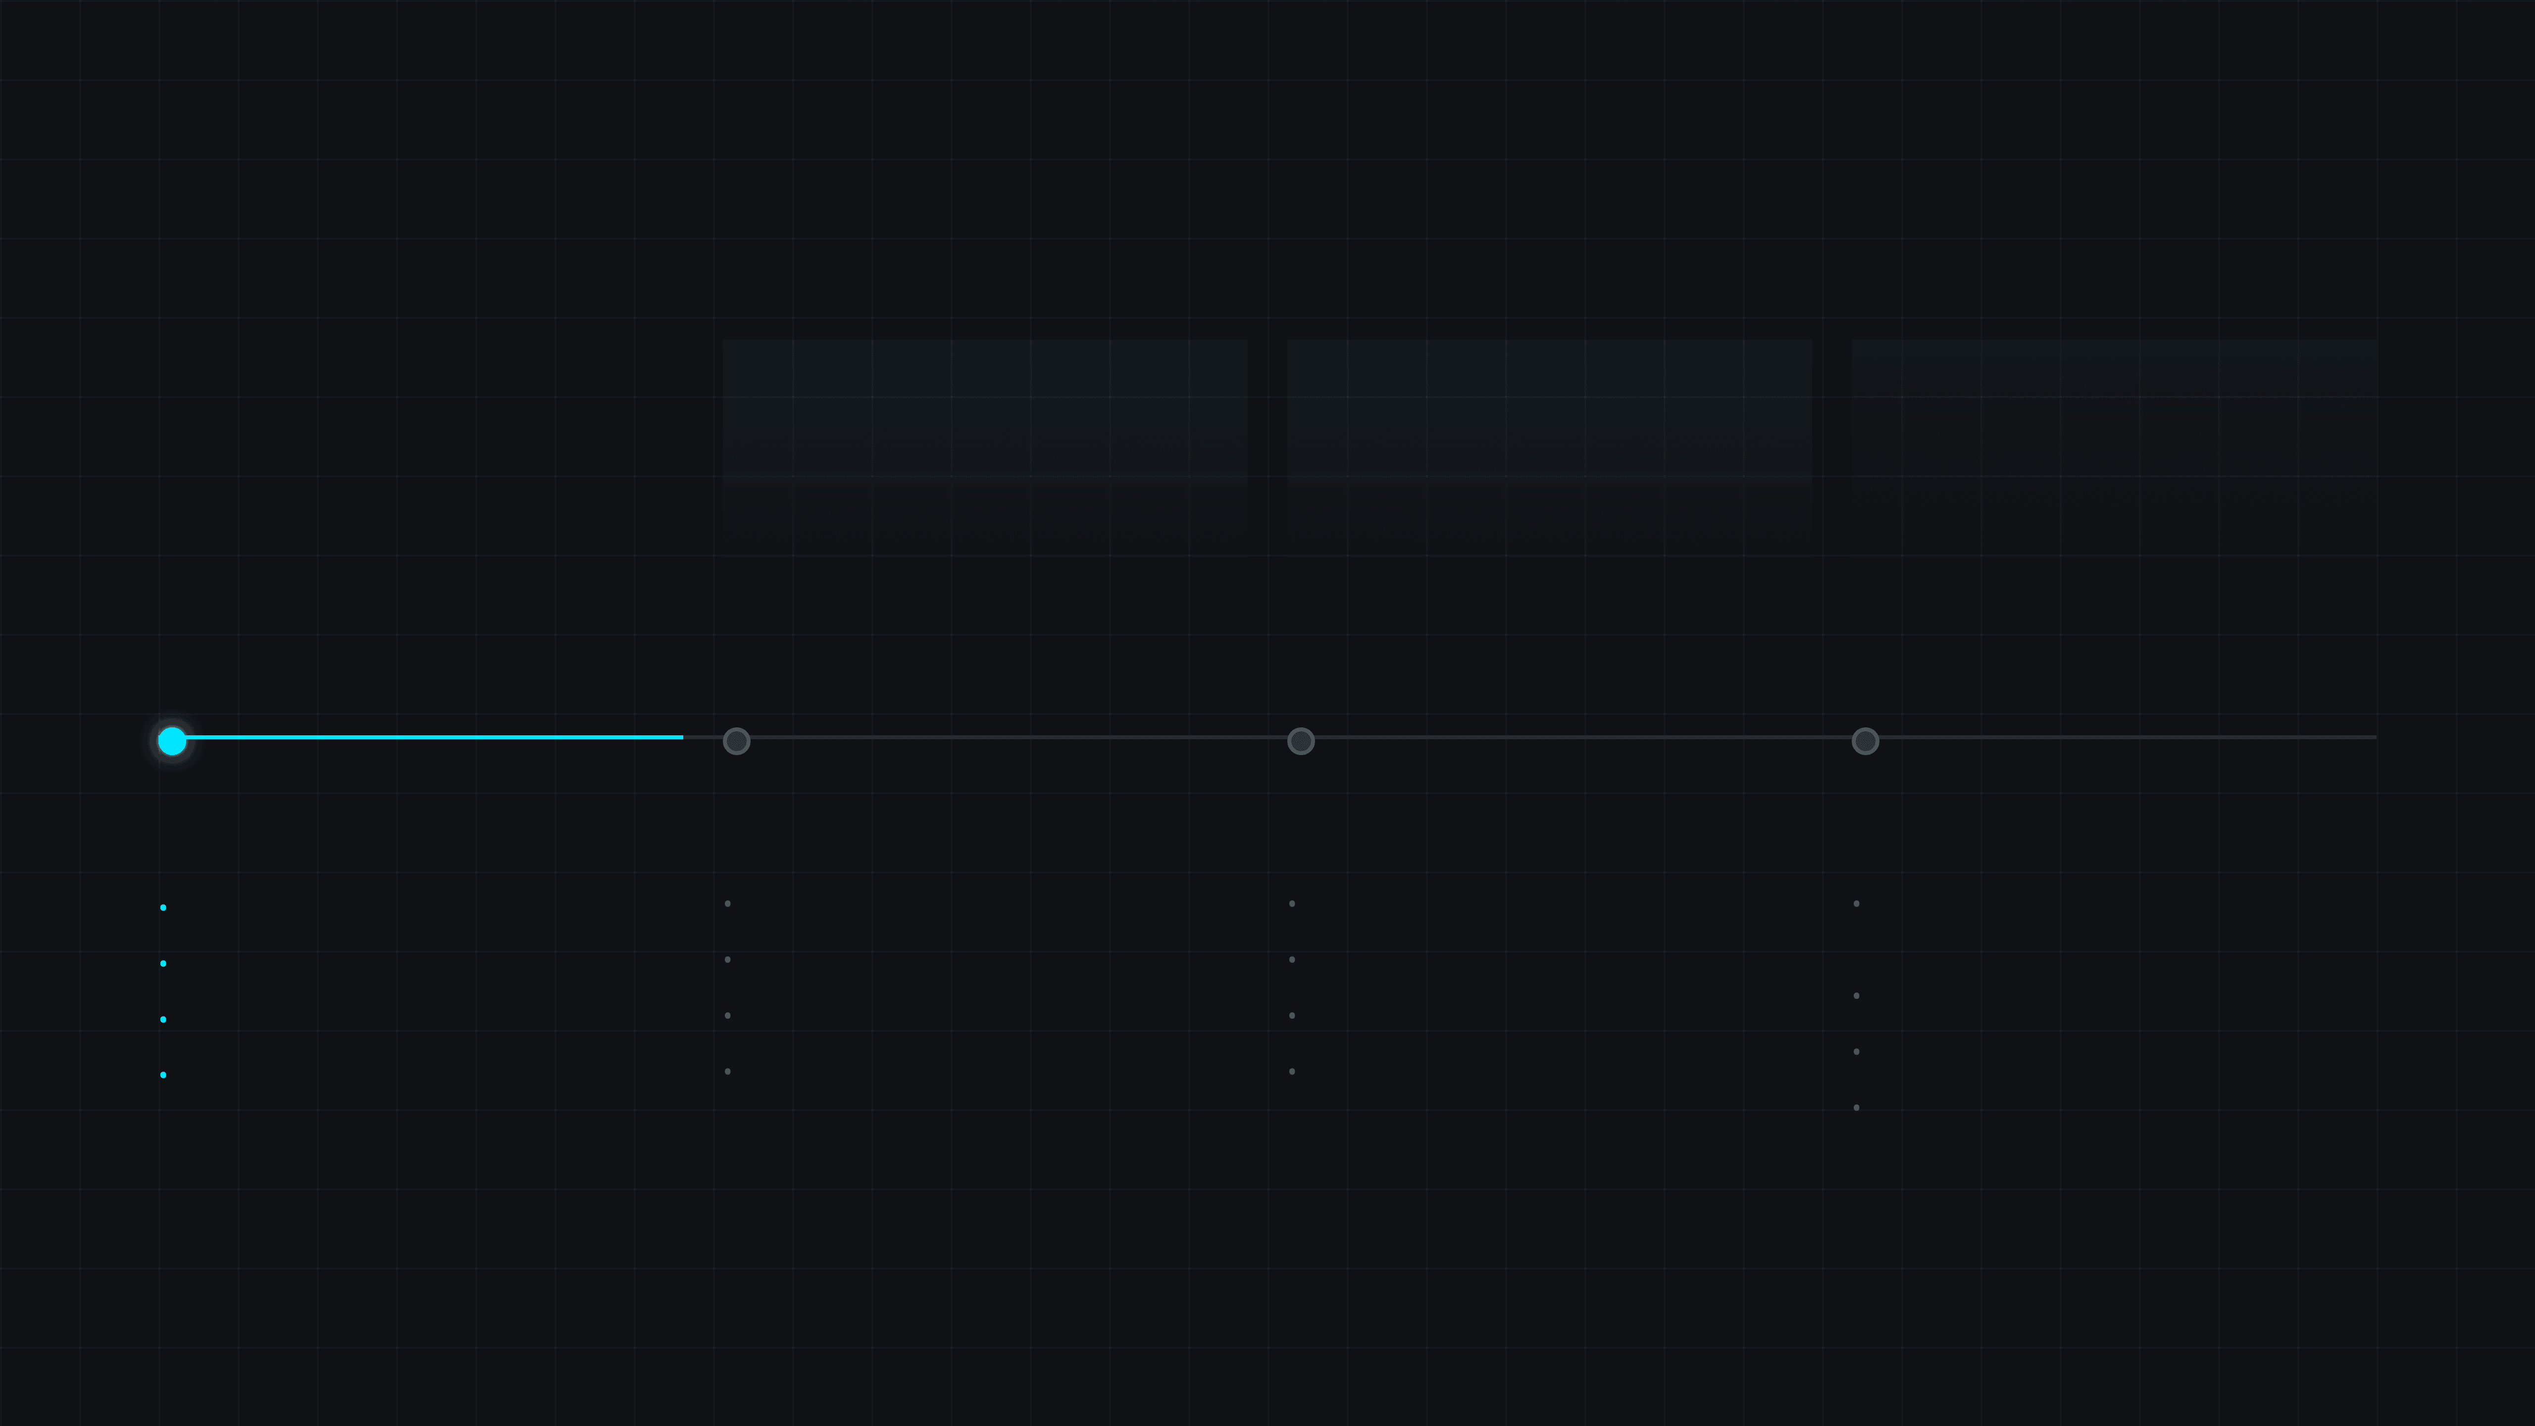

Traction & Roadmap
Platform MVP Live with $500K Secured
Product Status
Data Integration
Pilot Program
Contract Value
Platform MVP
1 ISO Live
3 Customers
$500K
Core Architecture Live
Real-time Data Feed
2 Developers, 1 Utility
Secured Revenue
18-Month Product Roadmap
Q1 2026
CURRENT
Q2-Q3 2026
Q4 2026 - Q1 2027
Q2-Q3 2027
Interconnection Foundation
Workflow Automation
Energy Prices & Congestion
Advanced Analytics
•
Queue analysis & capacity assessment
•
Advanced cost allocation modeling
•
Integrating with external APIs
•
Cloud Based Power Flow for Site Screening
•
PJM TC2 Phase 1 results live
•
Automated stakeholder workflows
•
LMP Prices & Basis Analysis
•
Tariff navigation – PJM
•
Expand to MISO, SPP, NYISO, ISONE
•
Curtailment Analysis & Due Diligence
•
Future Projects & Scenario Modelling
•
Tracking Transmission Upgrades
•
Developer dashboard and alerts
•
Expand to ERCOT, CAISO, WECC
•
Data room integration for M&A
•
Advanced Visualization (Geospatial)

Slide 11
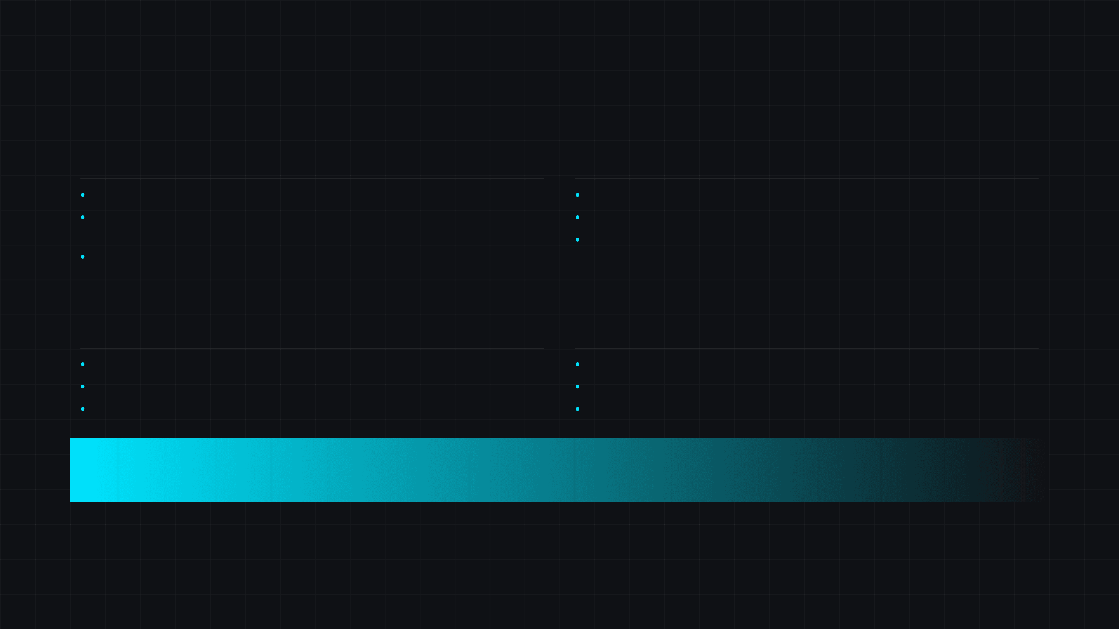
Why GridAgent Will Win
Technical Differentiation Meets Perfect Market Timing
01
Technical Differentiation
02
Market Timing
AI Layer Agent: Native intelligence orchestration layer for Power Markets.
"Goldilocks" Moment: Convergence of urgency, budget, and maturity.
Real-Time Data: Integration with comprehensive US power market data sources.
Interconnection Crisis: Demands immediate solutions for 2.2 TW backlog.
Digital Readiness: Utilities increasingly open to capitalized software spend.
Embedded Expertise: Years of domain knowledge built directly into agent reasoning.
03
Go-to-Market Advantage
04
Team & Execution
Developer Wedge: Land with developers for fast validation and case studies.
Deep Expertise: Rare combination of AI/ML and power systems engineering.
Enterprise Expansion: Leverage proven ROI to penetrate enterprise accounts.
Proven Navigation: Ability to handle complex consulting cycles.
Cross-Sell: Expand from Interconnection to planning & operations.
Capital Efficiency: Clear path to profitability with disciplined growth.
The Vision
GridAgent will become the first AI Powered Intelligent automation layer powering the modern US power grid, enabling the energy transition and supporting economic growth.

Slide 12



Appendix: Acronym Guide
Industry Terminology Reference
Industry Terminology
Business & Technical
IOU
Investor-Owned Utility
GW / TW
Gigawatt / Terawatt
e.g., PG&E, Duke Energy
10⁹ watts / 10¹² watts
ISO/RTO
Independent System Operator / Regional Transmission Org
CapEx
Capital Expenditure
Long-term asset investment
FERC
Federal Energy Regulatory Commission
OpEx
Operating Expenditure
Day-to-day expenses
NERC
North American Electric Reliability Corporation
SaaS
Software as a Service
DER
Distributed Energy Resources
Solar, Battery, EV
ACV
Annual Contract Value
DLR
Dynamic Line Rating
CAGR
Compound Annual Growth Rate
Real-time capacity monitoring

